Slide 1
One is the Loneliest Number The Solo PD
Javier Espinales, CST, M.Ed.

Slide 2
Today’s Objectives
Discuss the job of the PD and the responsibilities of the job.
Identify the resources of your program.
Create/review the curriculum for your program.
Acquire assistance.

Slide 3
My Journey
Retired from the Army in 1999 – last position training soldiers to be an ST.
First college Virginia College, Austin, TX 2003 - 8½ years
Second college Brown Mackie College, San Antonio – 3½ years
Currently Concorde Career College, San Antonio, for over 9 years

Slide 4
The job of the PD and the responsibilities of the job.
Start with your institutions job description.
Attend an ARC/STSA Accreditation Fundamentals for Educators (AFE) workshop.
Go online to https://ARC/STSA.org , https://AST.org and https://NBSTSA.org Bookmark them.

Slide 5
Identify the resources of your program.
Program Setup
Best Practice Guide for Surgical Technology
Standard III. Resources, page 5
A. Type and Amount
B. Personnel
C. Curriculum
D. Resource Assessment

Slide 6
Identify the resources of your program.
A. Type and Amount
Faculty
Administrative and support staff
Curriculum
Finances
Faculty and workspace
Space for confidential interaction
Classroom & laboratory
Ancillary student facilities
Clinical affiliates
Equipment
Supplies
Information technology
Instructional materials
Support for faculty professional development

Slide 7
Identify the resources of your program.
Program Setup
Best Practice Guide for Surgical Technology
Standard III. Resources, page 5
A. Type and Amount
B. Personnel
C. Curriculum
D. Resource Assessment

Slide 8
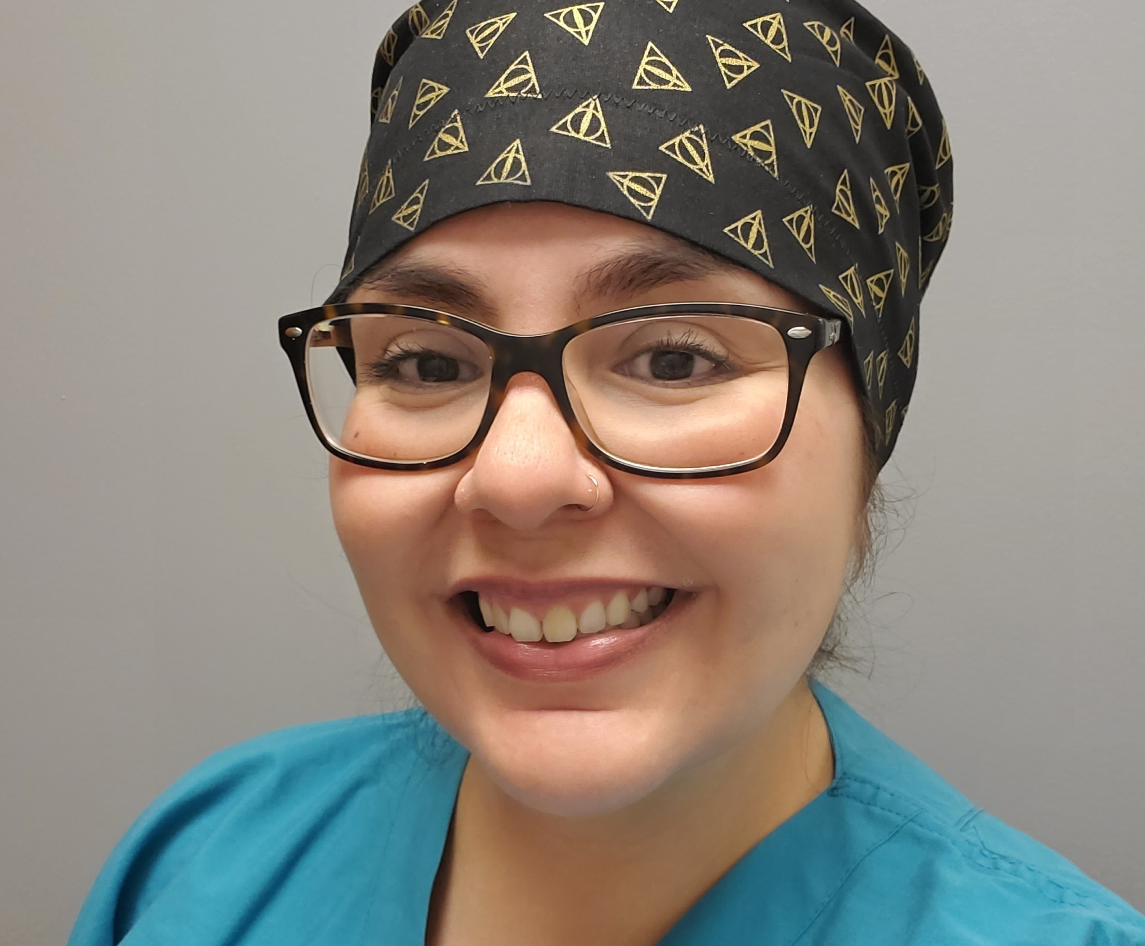
B. Personnel
You need a team!

Slide 9
Identify the resources of your program.
Program Setup
Best Practice Guide for Surgical Technology
Standard III. Resources, page 5
A. Type and Amount
B. Personnel
C. Curriculum
D. Resource Assessment

Slide 10
Identify the resources of your program.
C. Curriculum
The AST Core Curriculum, 7 Ed.
Must be implemented Aug 2024

Slide 11
Identify the resources of your program. Use the CCST-7e Curriculum Comparison Map

Slide 12
Identify the resources of your program. Best Practice Guide for Surgical Technology Education (Formally SIG)

Slide 13
Identify the resources of your program.
Program Setup
Best Practice Guide for Surgical Technology
Standard III. Resources, page 5
A. Type and Amount
B. Personnel
C. Curriculum
D. Resource Assessment

Slide 14
Identify the resources of your program. D. Resource Assessment
Program Evaluation Plan (PEP)

Slide 15
Identify the resources of your program. D. Resource Assessment
PAC

Slide 16
Create/review the curriculum for your program.
The AST Core Curriculum, 7 Ed.

Slide 17
Acquire assistance.

Slide 18
Acquire assistance.
Talk with you administrator
Reach out to ARCSTSA
Use your network

